Slide 1

Soap Dish Presentation
Everett Barry, Jr
Senior Design Engineer
Bathroom Accessories Sales
March 23, 2015

Slide 2
Executive Summary
The Concept
Proposal of a attractive and innovative soap dish design
Reduced overhead costs
Increased customer satisfaction
The Potential
Increase company reputation and future business opportunities
The Opportunity

Slide 3
What We’ll Cover Today
Current issues with current modern soap dishes
Proposed new soap dish product design
Costs on return and investment projections
Targeted clientele strategy sales and marketing needs
Questions and suggestions

Slide 4
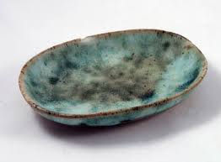
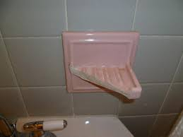
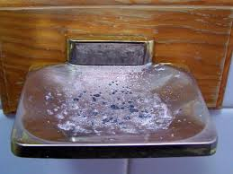
Issues with Current Soap Dish Models
Current Issues Soap Dishes
Tend to build up Lime scale
Inability to Properly Store Soap
Difficult to Clean up
Composed of Fragile Material
Lack of Excess Water Irrigation
Inability to Utilize Full Usage of Soap
Accumulates Unsanitary Soap Scum Residue Over Time

Slide 5
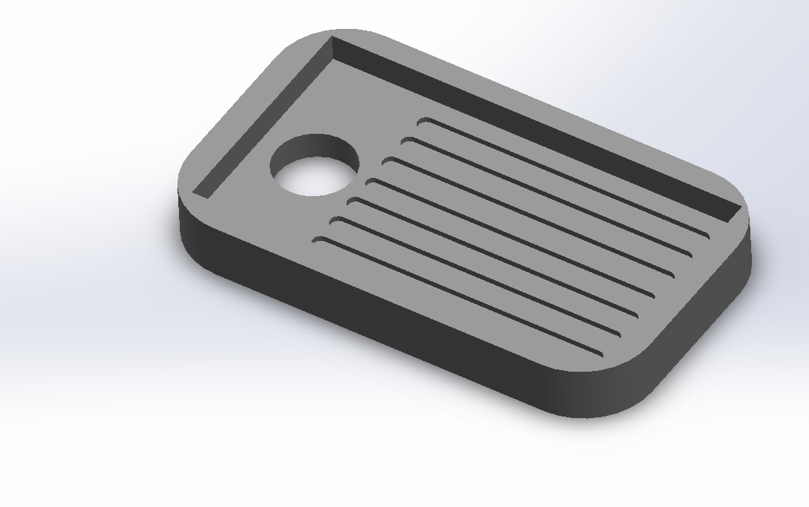
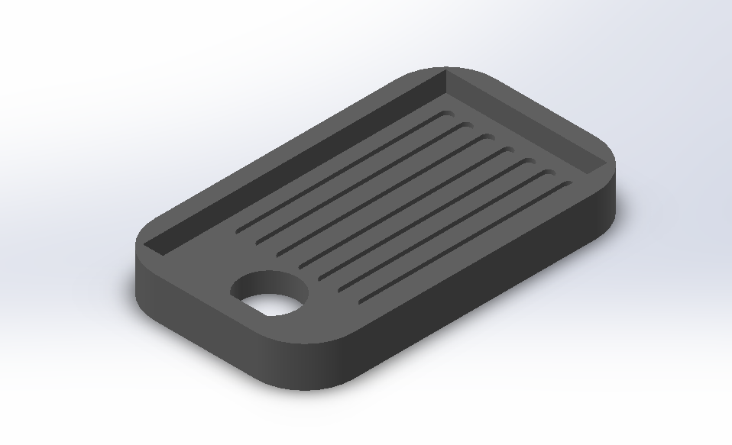
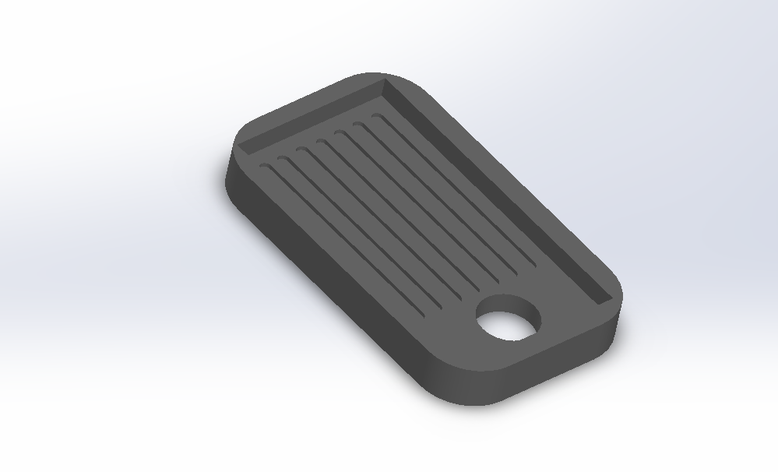
Proposed New Soap Dish Design
Benefits Of the Design Include:
Composed of Recycled Rubber Materials such as used Tires
Curvature Design Enable Stable Soap Storage
Rubber Compound Composition Enables the Product to be virtually Indestructible
Easy Rinse Dishwasher Safe For Easy Cleanup Maintenance
Fluid Irrigation Hole to Chanel Excess Water Away from the Soap
Power Coated to Prevent Unsanitary Sticky Soap Residue to Accumulate over Time

Slide 6
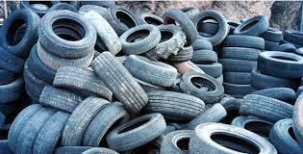
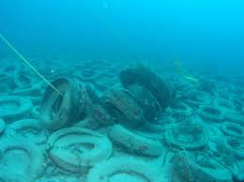
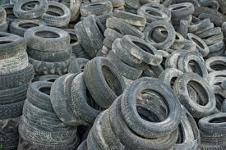
Key Benefits Of the Design
Composed of recycled rubber compound material from used tires. Therefore reduces material cost to manufacture the product.
Usage of composed material helps reduce pollution.
Categorizes the product as “Eco-Friendly”.
Allows the product to be more marketable due to is environmentally safe character of its design.
Inexpensive to produce leading to increased profit.

Slide 7
Targeted Customers
Average Family and Student Households
Families whose household contain small children and pets.
Senior Citizens
College Students

Slide 8
Manufacture Cost of 1 Soap Dish
Expense Area | Results
Revenue | $5.00 | per | unit
Cost of Material | $0.85 | per | unit
Total Manufacturing Expenses | $1.05 | per | unit
Gross Profit | $3.95 | per | unit
Pre-Tax Profit as Percent of Revenues | 79% | per | unit

Slide 9
Costs of Return on Investment Projections of Units

Slide 10
Sales and Marketing Needs
Close sales faster
Present complex concepts quickly and clearly such as benefits and cost to customers.
Increase advertising to reach more clientele in areas.

Slide 11
Questions and Suggestions?

Slide 12
THANK YOU FOR YOUR TIME

